Slide 1

KKBox's Churn Prediction
Course Name:Big-Data Sys Engineering Using Scala
Group members : Difu Chen, Haimin Zhang, Tianrun Gao

Slide 2
What’s the churn?
Why do we perform churn analysis?

Slide 3
Customer churn is the loss of client or customers(also known as customer attrition or customer defection).
KKBOX is Asia’s leading music streaming service, holding the world’s most comprehensive Asia-Pop music library with over 30 million tracks.
Building a model to predict whether a user will churn when their subscription to KKBox expires
What are we doing?
Why are we doing this?
Accurately predicting customer churn is critical to long-term success
Slight improvements in accuracy can lead to dramatic improvements in profit

Slide 4
Why are we doing this?
Accurately predicting customer churn is critical to long-term success
Slight improvements in accuracy can lead to dramatic improvements in profit

Slide 5
Data sources

Slide 6
Data source link: https://www.kaggle.com/c/kkbox-churn-prediction-challenge
KKBOX is Asia’s leading music streaming service, holding the world’s most comprehensive Asia-Pop music library with over 30 million tracks.
The training and the test data are selected from users whose membership expire within a certain month. The train data consists of users whose subscription expires within the month of February 2017, and the test data is with users whose subscription expires within the month of March 2017.
In this dataset, KKBox has included more users behaviors than the ones in train and test datasets, in order to enable participants to explore different user behaviors outside of the train and test sets.
Notes:
Data sources 介绍数据量的大小，多少record，有什么字段之类的

Slide 7
The dataset consisted of subscriber data from 3 distinct sources: user activity logs, transactions, and member data. 3 years of historical data were included.
User log data included a variety of information about subscriber activity by day
Transaction data covered all payment and subscription information including renewals and cancellations
Member data contained demographic information about each subscriber such as birthdate and gender
Notes:
Data sources 介绍数据量的大小，多少record，有什么字段之类的

Slide 8
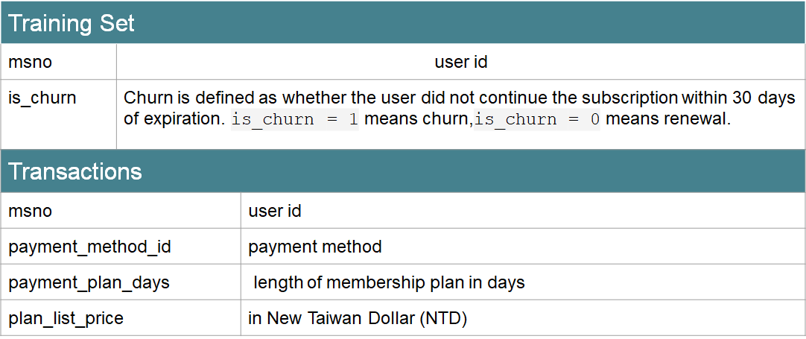
The dataset consisted of subscriber data from 3 distinct sources: user activity logs, transactions, and member data. 3 years of historical data were included.
User log data included a variety of information about subscriber activity by day
Transaction data covered all payment and subscription information including renewals and cancellations
Member data contained demographic information about each subscriber such as birthdate and gender
Notes:
Data sources 介绍数据量的大小，多少record，有什么字段之类的

Slide 9
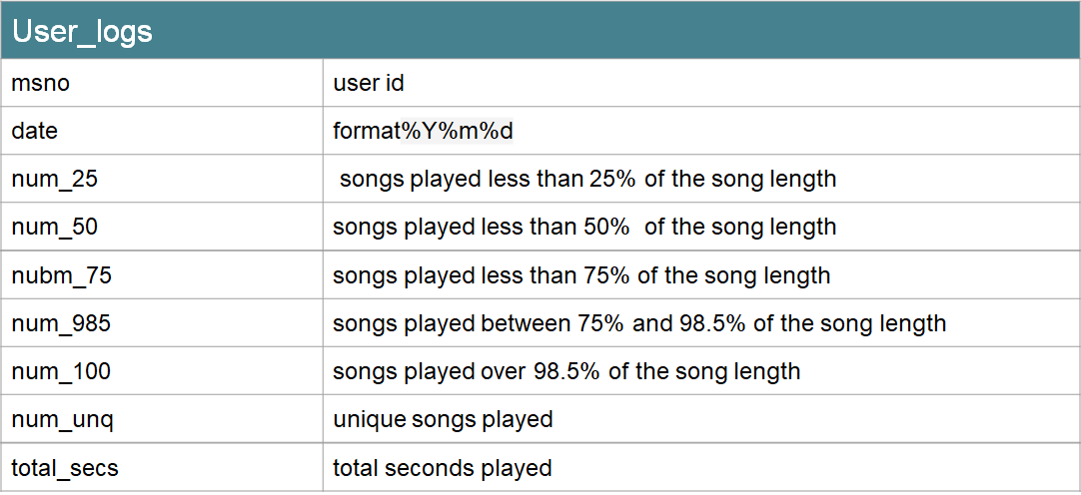
The dataset consisted of subscriber data from 3 distinct sources: user activity logs, transactions, and member data. 3 years of historical data were included.
User log data included a variety of information about subscriber activity by day
Transaction data covered all payment and subscription information including renewals and cancellations
Member data contained demographic information about each subscriber such as birthdate and gender
Notes:
Data sources 介绍数据量的大小，多少record，有什么字段之类的

Slide 10
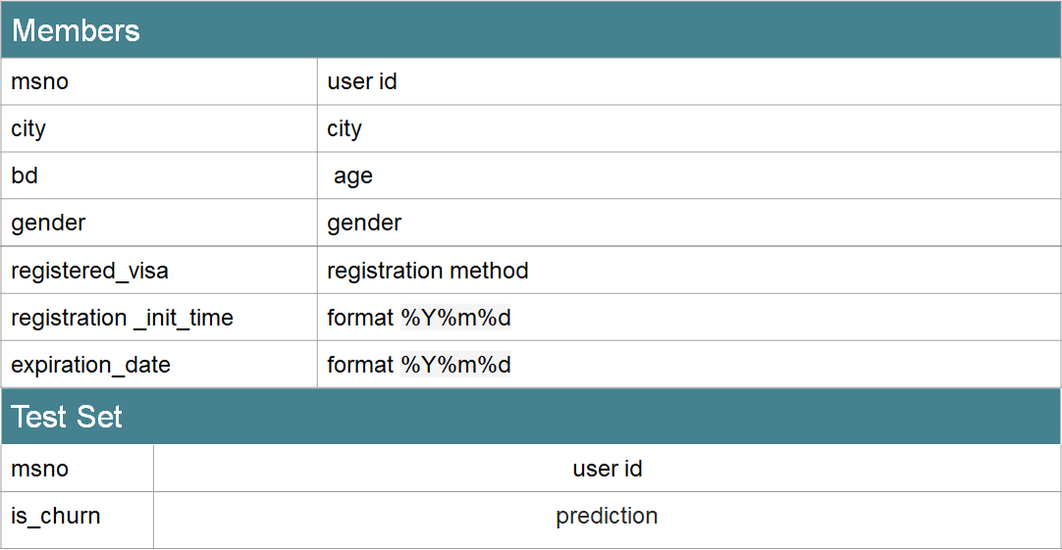
The dataset consisted of subscriber data from 3 distinct sources: user activity logs, transactions, and member data. 3 years of historical data were included.
User log data included a variety of information about subscriber activity by day
Transaction data covered all payment and subscription information including renewals and cancellations
Member data contained demographic information about each subscriber such as birthdate and gender
Notes:
Data sources 介绍数据量的大小，多少record，有什么字段之类的

Slide 11
Use Cases

Slide 12
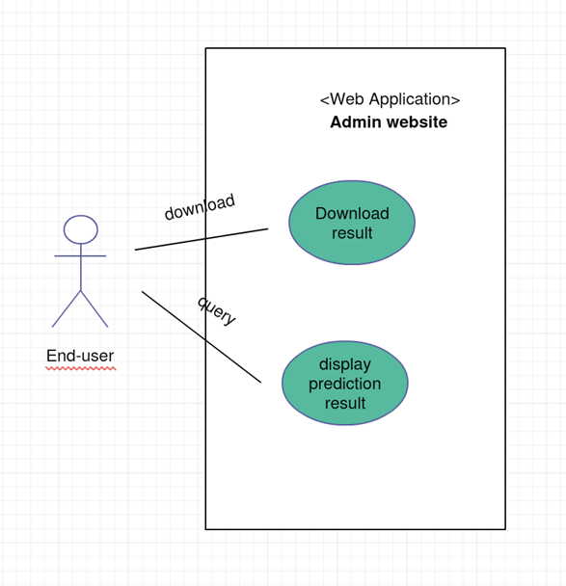
Notes:
User cases的要求：做了什么实际操作，返回了什么结果

Slide 13
Methodology

Slide 14
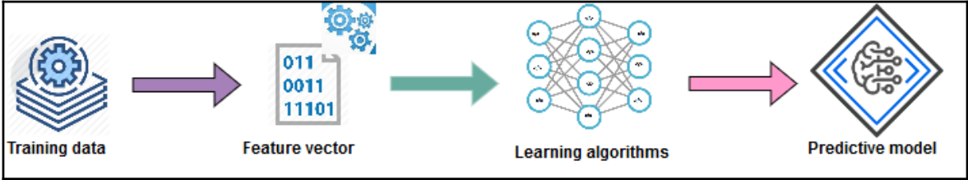
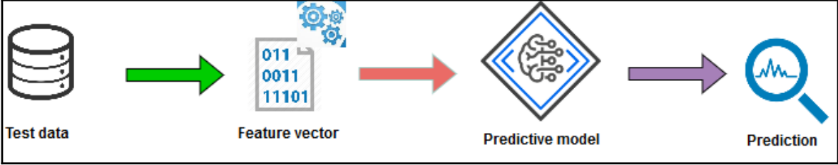
Learning Stage:
Training data and preparing feature vectors
Preparing the learning algorithm and training the algorithm to prepare the predictive model
Inference Stage:
Testing model against new data
Evaluating the performance of the model itself

Slide 15
Milestones

Slide 16
Week 1: Preprocess the churn data and do the feature engineering
Week 2&3: Implemented the suitable machine learning algorithms to calculate the churn data for making prediction and build the system based on the ML algorithms
Week 4: Develop the website to show the predicted list for users

Slide 17
Scala program
&
Code repository

Slide 18
Scala program
Program about preprocessing the churn data
Program about machine learning algorithms to calculate the churn data for detecting the customer churn
Program about business service
Notes:
More specific

Slide 19
Code repository
https://github.com/hmaccelerate/Churn_rediction

Slide 20
Acceptance criteria

Slide 21
The precision of Churn archives 85%
Complete functionality
Bug free
No business logic error

Slide 22
Goals of the project

Slide 23
Provide the good user interface to have good experience
Build Strong program that preprocess a large amount of churn data
Implement Strong algorithm that have the good prediction accuracy of customer churn
Build system that cope with errors during execution and cope with erroneous input

Slide 24
Thank You!

